Slide 1
Scalability and Asynchronous Programming
Ethereum 2.0… now processing 100,000 towers of ugly javascript callback code per second!

Slide 2
Ethereum right now
Every node processes every transaction
Every node stores all of the state
Sloooowwwww….
And, unlike nearly all other systems, does NOT get more powerful the more nodes join the network

Slide 3
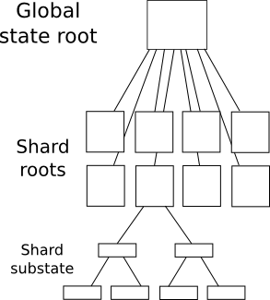
A Vision for 2.0: Sharding

Slide 4
A Vision for 2.0: Sharding
State split into shards
Each account is in one shard
Accounts can only send transactions to or call accounts in the same shard

Slide 5
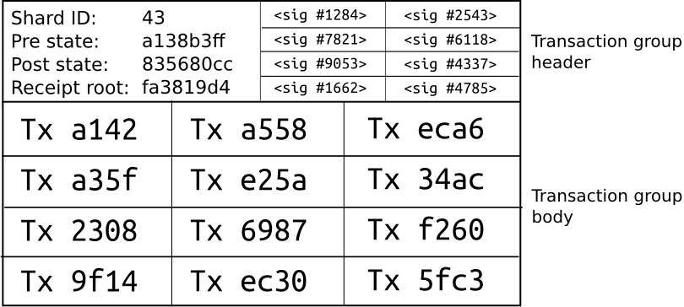
The Bottom Level

Slide 6
The Bottom Level
Every transaction specifies a shard ID
A transaction “in” shard X implies that it sends from and to an account in shard X
A transaction grouping in shard X contains zero or more transactions in shard X
Specifies pre-state root and post-state root for that shard

Slide 7
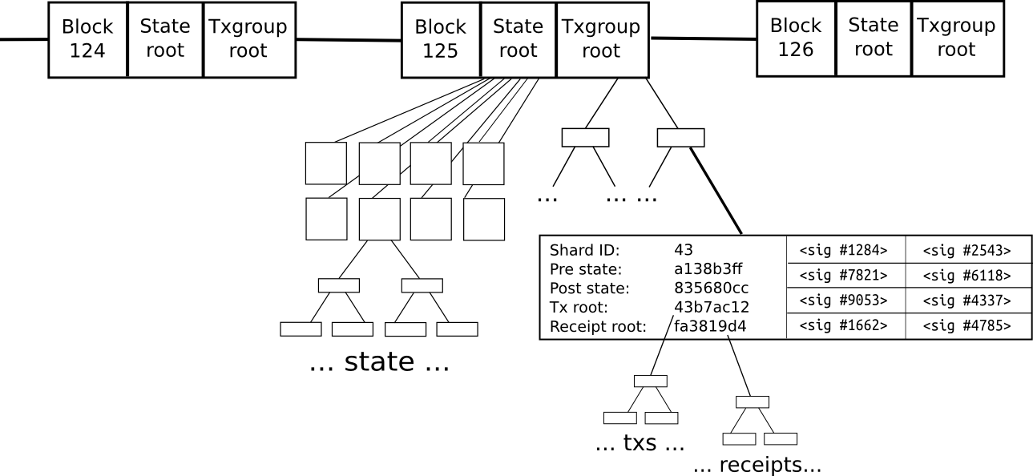
The Top Level

Slide 8
The Top Level
Think of the top-level as a non-scalable, Ethereum 1.0-style, blockchain, with a funny state transition function
Tx is valid if:
Pre-state root equals shard root in global state
Signatures (⅔ of a randomly pre-selected set of 135) are valid
Shard root in global state becomes post-state root

Slide 9
Async Transactions
Q: how do we do cross-shard transactions?
Problem: if we allow cross-shard calling, then parallelization becomes impossible

Slide 10
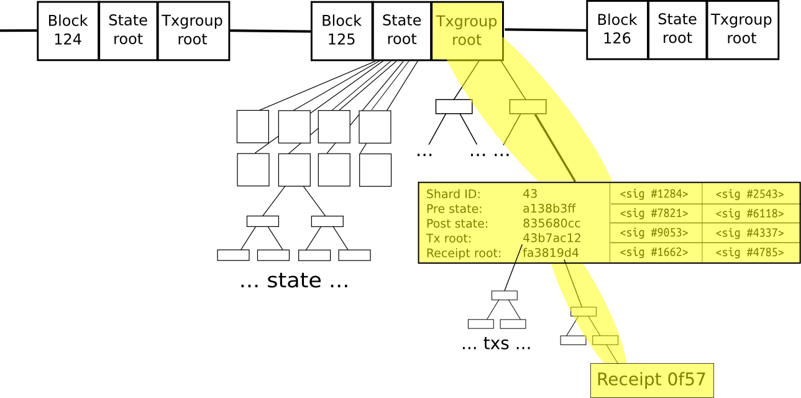
Solution: Merkle tree receipts

Slide 11
Step 1: The Call
def registerName(currencyShard, currencyAddress, name, fee):
self.next_cbid += 1
log(type=CallReceipt, {
shard: currencyShard, to: currencyAddress,
method: withdraw, args: {
from: msg.sender, to: self, value: fee,
}
cbid: self.next_cbid, callbackMethod: withdrawCallback
})
self.cbArgs[self.next_cbid] = {
name: name, owner: msg.sender,
shard: currencyShard, to: currencyAddress
}

Slide 12
Step 2: The Other Side
def submitLog(logProof):
if verify(logProof, block.prevStateRoot) and
not self.spent[logProof.log.cbid] and
log.shard == myShard and log.to == self:
self.spent[logProof.log.cbid] = true
o = self.call(method=log.method,
sender=log.sender,
senderShard=log.senderShard, **log.args)
log(type=CallReceipt, {
response: o, shard: log.senderShard, to: log.sender,
method: log.callbackMethod, args: { response: o },
cbid: logProof.log.cbid
})

Slide 13
Step 3: Callback
def submitCallback(logProof):
cbid = logProof.log.cbid
if log.sender == self.cbArgs[cbid].to and
log.senderShard == self.cbArgs[cbid].shard and
verify(logProof, block.prevStateRoot) and
not self.spent[cbid]:
self.spent[cbid] = true
self.call(method=log.method,
**self.cbArgs[cbid], **log.args)
def withdrawCallback(name, owner, response):
if response is true:
self.domains[name].owner = owner

Slide 14
Asynchrony in Practice
Three main use cases for cross-contract calling
Get information
Send an action without response (eg. transfer funds)
Send an action with a response (eg. withdraw funds + success/failure)
The second is not problematic at all, the first and third can be

Slide 15
Problems and solutions
Race conditions
Mutual exclusion locks
Async programming is hard
Javascript-style callbacks
Promises
async.map, etc

Slide 16
The economics
In a scalable model, contract-to-contract calling requires actual transactions, not just virtual messages
This can be made censorship-resistant: there is common knowledge that info to create sub-calls exists, so sub-calling can be compelled
Incentivization for sub-calls?

Slide 17
The economics
Transactions pay fees to group creators, group creators pay fees to blockmakers
Incentives still fine: blockmakers want to include highest-fee-paying groups, group creators want to include as much as possible both for own benefit and to get as high fees as possible
Maybe anti-spam PoW is required on groups?

Slide 18
More generality
First k bits of an address is a shard ID
Every transaction (and every transaction group sets its own k)
Attempting to synchronously call a contract outside of a shard triggers an OOG-like exception
Transaction groups on all k have same gas limit
Gas price proportional to 2^{-k} in equilibrium

